Slide 1
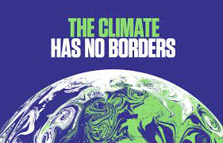
You are the future...
How can you make it better?

Slide 2
COP26 and the Environment
The COP 26 summit being held in Glasgow has highlighted further the dangers that there are to our local environment and more broadly the world in which we live.
This survey is a chance for you to share your opinions, about the areas that you feel are important both for your school, local community, and the world in which we live.

Slide 4
Eco Group
You may have been part of an eco group in
primary school or your school may have even
been an Eco-school and earned one of its flags.
In Bridge of Don Academy there is no longer an Eco-group, but if there was demand for it, this could change.
However, there are various lunchtime clubs that still allow you to get your views about change across such as Global Goals.

Slide 5
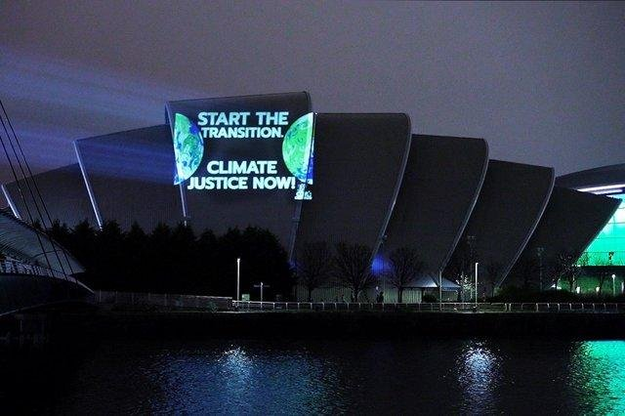
COP26 (COP means ‘Conference of Parties’)
COP26 is the 2021 United Nations climate change conference
In that time climate change has gone from being a fringe issue to a global priority. This year will be the 26th annual summit – giving it the name COP26. With the UK as President, COP26 takes place in Glasgow.
It takes place between 31st October and 12th November at the Events Campus in Glasgow.

Slide 6
COP26
Why do we need COP?
The world is getting warmer because of fossil fuel emissions caused by humans.
Icecaps are melting and sea levels are rising.
We are seeing more extreme weather events taking place around the world - including heatwaves, floods and forest fires, these naturally occurring events are being made worse because of the effects of climate change.
The past decade was the warmest on record, and governments around the world agree that urgent action is needed.

Slide 7
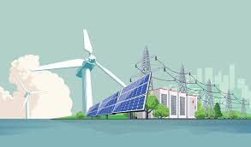
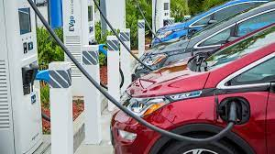
What can we expect from COP26?
COP26 will be biggest summit the UK has ever hosted. It is being described as the most significant climate event since the 2015 Paris Agreement.
Presidents and prime ministers from around the world will be reporting back on progress since the Paris Agreement and, hopefully, there will be some new decisions on how to cut carbon emissions.
Some commitments made in Glasgow could directly affect our daily lives. For example, environmentalists say big changes to how people live will be needed to hit climate targets, like people driving electric cars, moving away from gas heating, eating less red meat and not taking as many flights in the future.

Slide 8
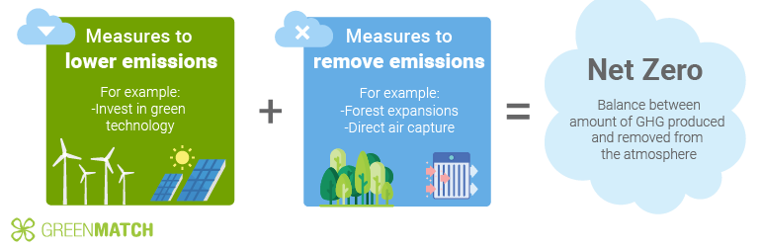
NET ZERO
The government has pledged to reduce the UK's carbon emissions to 'net zero' - which means cutting emissions drastically and absorbing as much carbon as it produces - by 2050. This means emissions from areas like transport, farming and industry will have to be avoided completely or offset by sucking carbon dioxide out of the atmosphere.

Slide 9
Please complete the survey in your year group Google Classroom. There is a link to it below too.
https://docs.google.com/forms/d/e/1FAIpQLSfzSFsxxMqHT5U_7EKhfKAtixMoKEqRN6knU4bkEXXHxoyQvQ/viewform

Slide 10
Sources
https://www.bbc.co.uk/newsround/51372486
https://www.lifewatch.eu/events/cop26/
https://en.wikipedia.org/wiki/Eco-Schools
https://www.pinterest.co.uk/pin/1084523153985728326/
https://www.greenmatch.co.uk/blog/2021/02/renewable-path-to-net-zero-emissions
https://theonebrief.com/asia/post/the-headwinds-hitting-the-renewable-energy-industry/
https://www.redbubble.com/i/poster/Eat-Less-Meat-by-markvickers41/43112398.LVTDI
https://www.forbes.com/consent/?toURL=https://www.forbes.com/wheels/advice/ev-charging-levels/
https://www.scotsman.com/news/environment/what-does-cop26-mean-meaning-of-the-name-of-glasgow-climate-change-conference-what-will-happen-and-what-the-letters-stand-for-3365590

