Slide 1
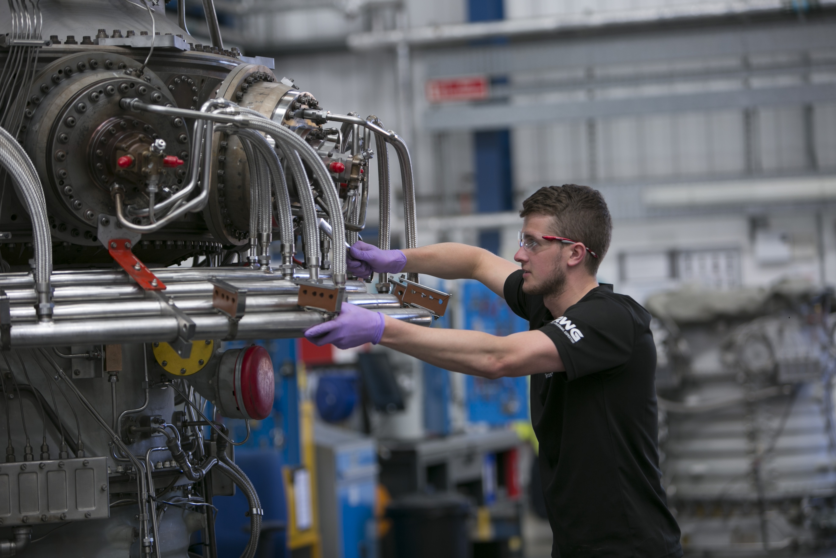
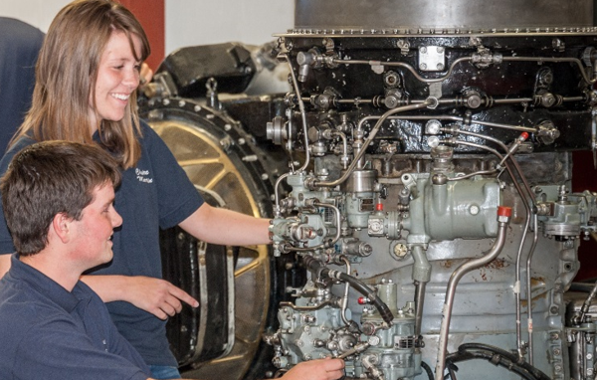
MODERN APPRENTICESHIP VACANCIES
RWG (Repair & Overhauls) Limited is a Siemens and Wood Company. We are a world leader in the repair and overhaul of gas turbines and their components. We maintain a global client base and have established a world class reputation for quality engineering in this field.
ship
If you are leaving school and enthusiastic to start work within the engineering industry or looking for an alternative to university, then why not consider our Modern Apprenticeship programme in the following disciplines:
Mechanical Fitter
Machinist
Engine Component Inspector
Sheet Metal Technician
Engine Testing Engineer
Desired qualifications:
National 5 grades A-B or equivalent in Maths and Physics
National 5 grade A-C or equivalent in English
TO APPLY:
For further information and application details, visit our apprenticeship page on our website www.rwgroup.com
Closing Date:
Friday 27th March 2020

