Slide 1

How to Revise 1

Slide 2
We are learning to know:
Why should you revise?
Where should you revise?
When should you revise?
How should you revise?
How often should you revise?

Slide 3

Why revise?
You forget things!
But you need these details to answer the question in the exam
You need to “top up” using the correct technique for you

Slide 4

Where?
What is wrong with this?

Slide 5

Where?
What is better about this?

Slide 6

When?

Slide 7
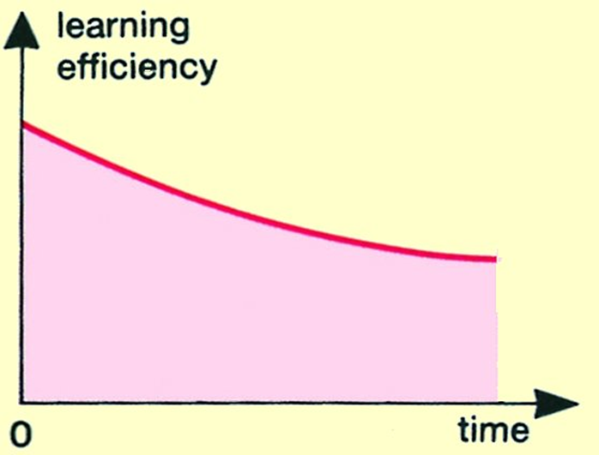
How should you revise?
If you just sit down to revise,
without a definite finishing time, then your learning efficiency falls lower and lower,like this:

Slide 8
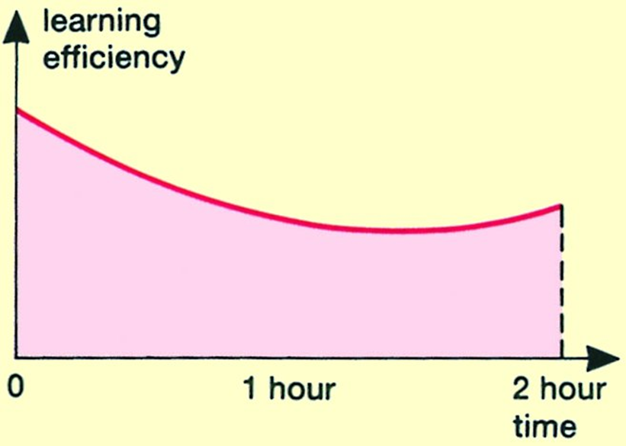
How can you improve this?
If you decide at the beginning how long you will work for, with a clock….
…then as your brain knows the end is coming, the graph rises towards the end

Slide 9
How can you improve this even more?
Break a two hour session up into 4 shorter sessions
4 x 25 minute sessions
3 x 5 minute breaks
Compare the next two graphs ………

Slide 10
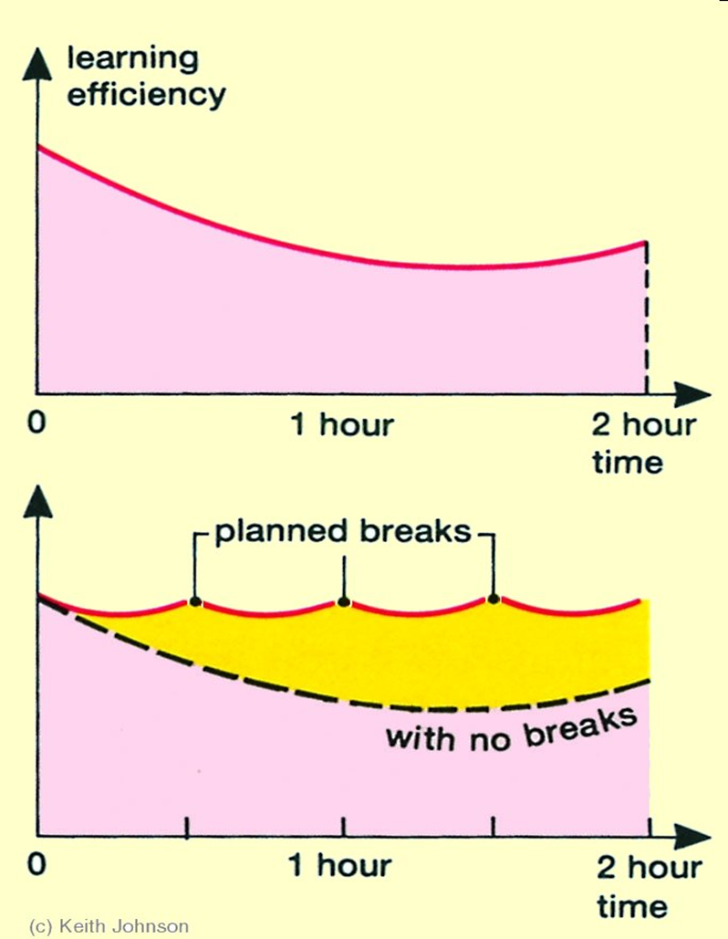

Compare these graphs
4 shorter sessions
The yellow area shows the improvement

Slide 11
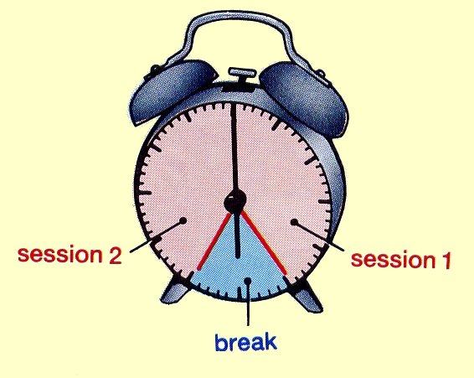
For example….
Suppose you start work at 6 pm.
You should decide, looking at your clock or watch, to stop at 6.25 pm …..and no later. At 6.25 pm have a break for 5-10 minutes
Then, when you start again, look at the clock and decide to work until 7 pm exactly, and then have another break.
This way, you are working more efficiently, as the previous slide showed.

Slide 12
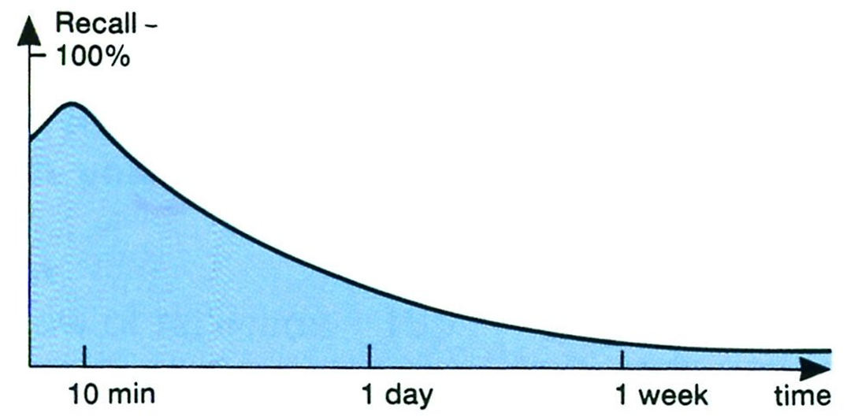
How often should you revise?
How much your brain can recall

Slide 13
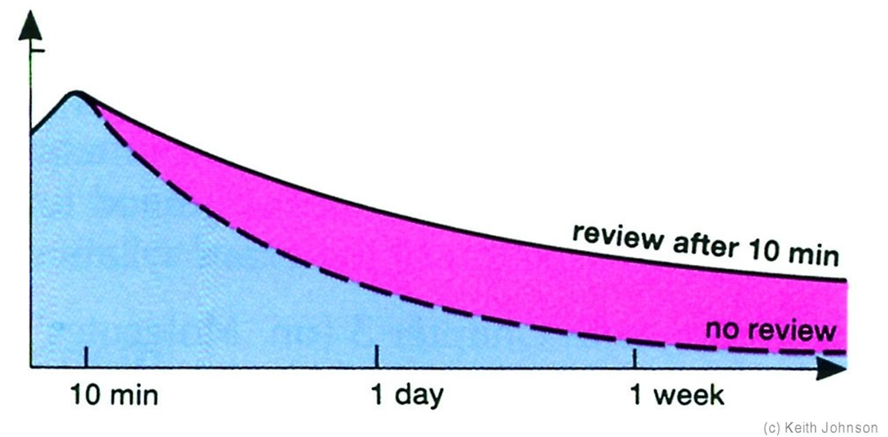
How much your brain can recall if you review your learning after 10 minutes

Slide 14
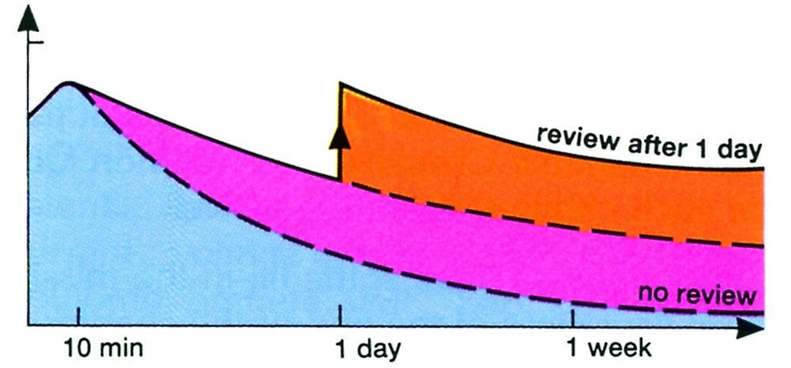
if you quickly re-revise again, after 1 day, then it falls even more slowly!

Slide 15
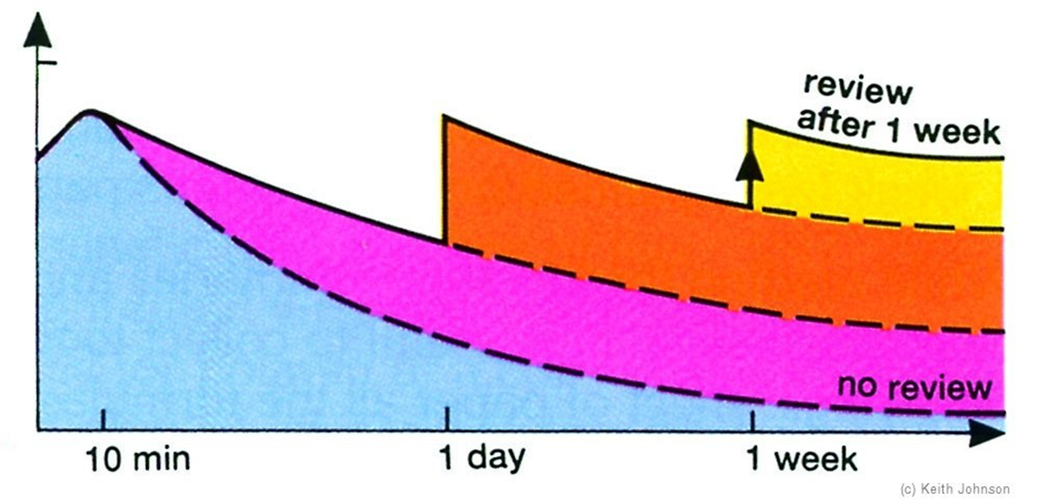
if you quickly re-revise again, after 1 week, then it falls even more slowly! Great!

Slide 16
Best intervals for revision…
10 minutes
1 day
1 week
…and then 1 month.

Slide 17



Resources for Revision
Three Main Publishers:
Hodder Gibson
Bright Red
Leckie and Leckie
Have a look at what is available in our library

Slide 18
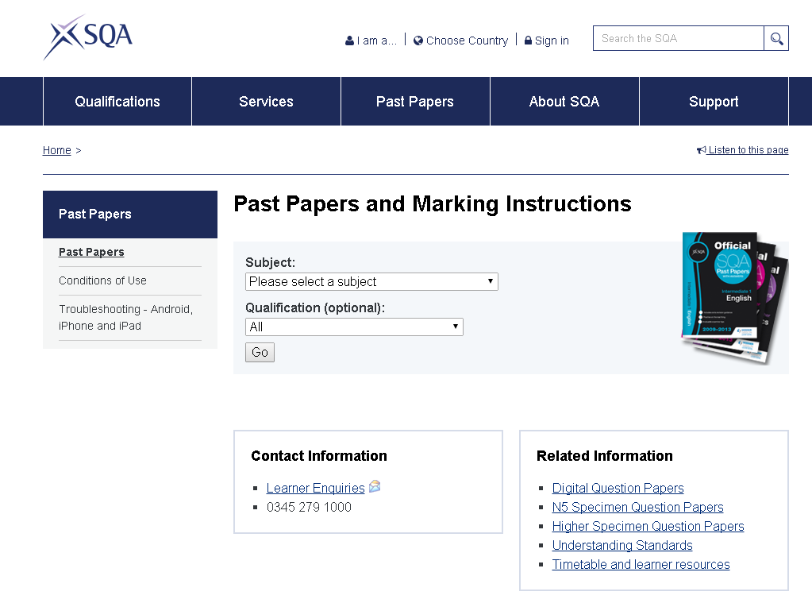
Internet Resources
http://www.sqa.org.uk/pastpapers/findpastpaper.htm
Select subject and qualification here

Slide 19
http://www.brightredbooks.net/subjects/
You will have to register to use the resources

Slide 20
http://www.bbc.co.uk/education
Remember to go to the section for Scotland to get resources for your courses

Slide 21
Internet Resources
Other schools have resources on their web sites:
Google Higher or National 5 followed by the subject and you will find a list to choose from. Some schools have made up their own resources some have used SQA materials.

Slide 22
It’s never too late to begin!
So get going!

Slide 23
Start planning now!

